Slide 1
CS 250 Agile Presentation
Nicholas Kreuziger

Slide 2

Contents
What Roles compose a Scrum Agile Team
How those roles execute a Software Development Lifecycle
How Agile Scrum differs from Waterfall Approach
Agile Scrum or Waterfall fit

Slide 3
Roles that Compose a Scrum Team

Slide 4

Product Owner
The Product Owner represents the business sponsor, is the decision maker for the project, provides direction to the team on what will be built, and prioritizes the work to be done (Cobb, 2015, Pg 35).
More responsibilities than a project manager, requires domain knowledge to define the business direction.
Clearly expresses, manages and prioritizes the Project Backlog.
Serves as a bridge of communication between Clients and the Scrum team.
A Product Owner is effective, focused and accountable to orchestrate a project to completion.

Slide 5

Scrum Master
The Scrum Master is a servant-leader for the Scrum Team. The Scrum Master helps those outside the Scrum Team understand which of their interactions with the Scrum Team are helpful and which ones aren’t. The Scrum Master helps everyone change those interactions to maximize the value created by the Scrum Team (Cobb, 2015, Pg 36).
Hosts Scrum Events (Daily meetings, Scrum Reflections)
Assists the Product Owner with an interpersonal focus on the Scrum Team and assistance with Product Backlog
Coaches Scrum Team Members and Organization on Scrum Practice
A Scrum Master is the oil that keeps an engine moving smoothly.

Slide 6

Developer
The Development Team consists of professionals who do the work of delivering a potentially releasable increment of “Done” product at the end of each Sprint. Only members of the Development team create the increment (Cobb, 2015, Pg 38).
Structured and empowered to manage their own work.
Self-Organizing
Cross-Functional
A developer is the productive force that utilizes the organization of the Product Owner and Scrum Master to focus on a functioning product.

Slide 7

Tester
The role of a tester in an Agile team includes activities that generate and provide feedback not only on test status, test progress, and product quality, but also on process quality (Kulkarni, 2018).
User Story Testing and Updating
Product Backlog Assistance
Configuring, using, and managing test environments
Supporting Team Members with Tester-Perspective and Mindset
A tester is the keen eye that implements QA in every step of the process.

Slide 8

4 Roles are sometimes better than 10
A well-assembled Scrum Agile team of 4 roles can handle a wide variety of projects.
A Product Owner and Scrum Master can effectively oversee an Agile Team’s problem-solving process.
Not every problem requires specialized roles with dedicated team support.
Agile Scrum Teams can fill the void when a unique business problem requires the skills of a diverse team.

Slide 9
Agile Approach
How does Agile Approach the Software Development Lifecycle

Slide 10
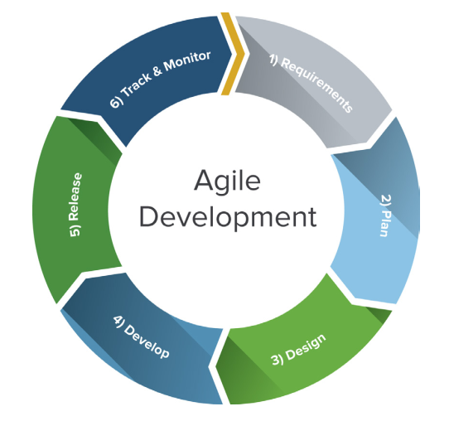
Agile Approach to the Software Development Lifecycle
Agile SDLC methodology is based on collaborative decision making between requirements and solutions teams, and a cyclical, iterative progression of producing working software. Work is done in regularly iterated cycles, known as sprints, that usually last two to four weeks. (What Is the Agile SDLC and How Does It Work? | Synopsys, n.d.)

Slide 11

Defining the Requirements
The level of planning on an agile project can be very different depending on the nature of the project. (Cobb, 2015, Pg 59). Agile Scrum planning has the philosophy that planning too far in advance involves guesswork and speculation, speculation that is wrong results in wasted efforts.
Rolling-wave planning is for projects with less unknowns, you draw a high-level map. You often reference the map for vision, scopes and objectives. When uncertainty arises, you can use the map to get back on course.
Spikes are used when too much uncertainty exists. Uncertainty is isolated and resolved separately from the development effort. Research, solution prototyping, or alternative approaches are considered. Isolating and time-boxing this resolution prevents it from slowing down the mainstream development effort.
Progressive Elaboration emphasizes that requirements should only be defined to support actions or decisions in the present-tense. They are not to be guesswork of the future. Without a reasonable estimate of effort, it is not fit into the sprint.
Value-based functional decomposition focuses on business value. Every vision statement defines the business value upfront. No guesswork!

Slide 12

Design The Solution
Often projects become too bloated. Project teams have a standard of going too far and gold-plating the solution. Simplicity is critical, adding too many solutions and overcomplication leads to reduced value in the results (Cobb, 2015, Pg 63).
Defining wants and needs. This saves time, money and effort so solutions can continually be adapted into future sprints.
Gathering comprehensive user personas and user stories tailors the solution to the need.
If there are many user stories to a problem, an Epic is drafted. This provides structure and targeted solutions that serve many needs.
Once adequately defined, User Stories and needs are on a Product backlog. This Product backlog is managed by the Scrum Team to prioritize and deliver results.

Slide 13

Implementing the Design (Coding)
An Agile Scrum Team is dedicated to a project and tightly integrated (Cobb, 2015, Pg 73). Think engineers designing a machine vs strangers fixing a broken-down car on the side of the road.
Any decisions about development or testing are integrated into the overall project management approach.
Cross-functional leadership is heavily emphasized and required of any leadership.
Functional requirements first, refactoring second.
Continuous Integration is the practice of frequently integrating new or changed software with the code repository and performing overall system integration testing throughout the project. Rather than pushing QA efforts to the last moment.
Test-driven development. Code is tested as it’s being developed.

Slide 14

Testing
The goal of each sprint is to clearly define what done means. This involves. . . (Cobb, 2015, Pg 78).
Code Review
Tested by Developers and QA
Accepted by the product owner and stakeholder
With testing well integrated into the development team, that definition of done allows for approval and review by the stakeholders and the Scrum Team as a whole. No backroom decisions about critical requirements or unexpected aspects of the final product.

Slide 15

Releasing
The Scrum Master and Product Owner coordinate with the customers for release planning.
This involves planning the release together and reviewing that all needs are fulfilled.

Slide 16
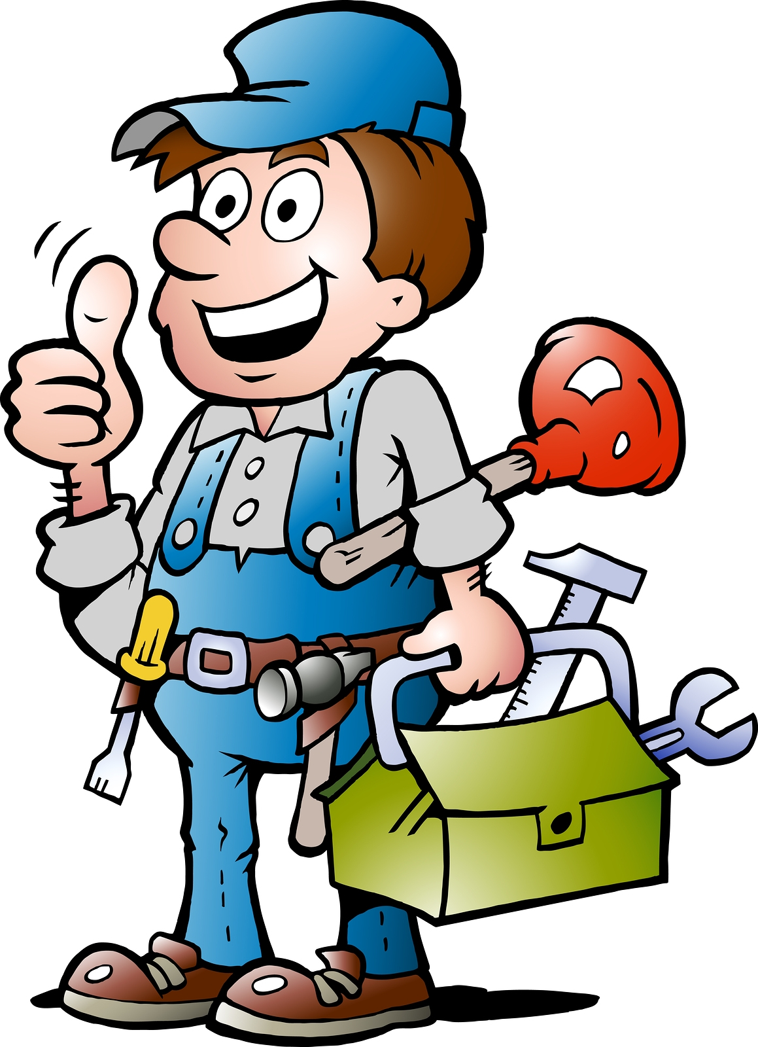
Maintenance
The Product Owner is there for the Scrum Agile team and the Stakeholder in the long-term. Monitoring of all releases is done to ensure satisfaction.
When problems or new needs arise, the user stories are logged onto the Product backlog for the Scrum Agile Team to prioritize and execute in Sprints.
This is a holistic approach that accounts for the needs of the Scrum Agile Team and the Stakeholders. Work is planned and predicted accordingly.
Security in a reasonable estimate of turnaround and focus from the development team on a high-quality product occurs in sprint-based development.

Slide 17
Waterfall Planning
What conclusions can be drawn about how waterfall planning would’ve handled change

Slide 18

If Waterfall planning had been used…
Much more time would’ve been invested in planning…(time is $$$)
When requirements changed, the original planners and decision makers would not be readily available.
Redefining requirements and plans for an entire project take time (a lengthy process).
A well-equipped Agile Scrum Team handles these moments by redefining the user story and recategorizing the need into the Product Backlog for Sprint execution.

Slide 19
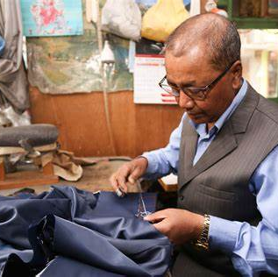
Solutions are tailored to problems
The approach must match the project. If you’re building a bridge across a river, it’s ridiculous to say we’ll build the first span and then decide how to build the remaining spans (Cobb, 2015, Pg 59).
A typical bridge can be defined.
What if the bridge is a new design? New designs require new and dynamic approaches.
When deciding between Agile and Waterfall driven projects, we’re deciding what type of bridge we’re tasked with building.

Slide 20


Waterfall or Agile
Waterfall
Agile
All planning is done in the first phase.
Plans are final once drafted.
Not as receptive to change.
Changes involves re-writing the roadmap.
Redefinition is not welcome.
Planning is done with user stories.
Those user stories can change.
Any changes and developments are executed in sprints of a defined length.
Redefinition is welcomed with open arms and added to the product backlog.

Slide 21

In summary…
Agile Scrum Teams are adaptable, dynamic, and ever evolving to adapt to an ever-changing business landscape.
A rigid project framework equates change to cost-increase. Agile Scrum Teams combat this by adaptation.
Transparent communication and project-management keeps the stakeholder (you) informed about the progress and results.

Slide 22
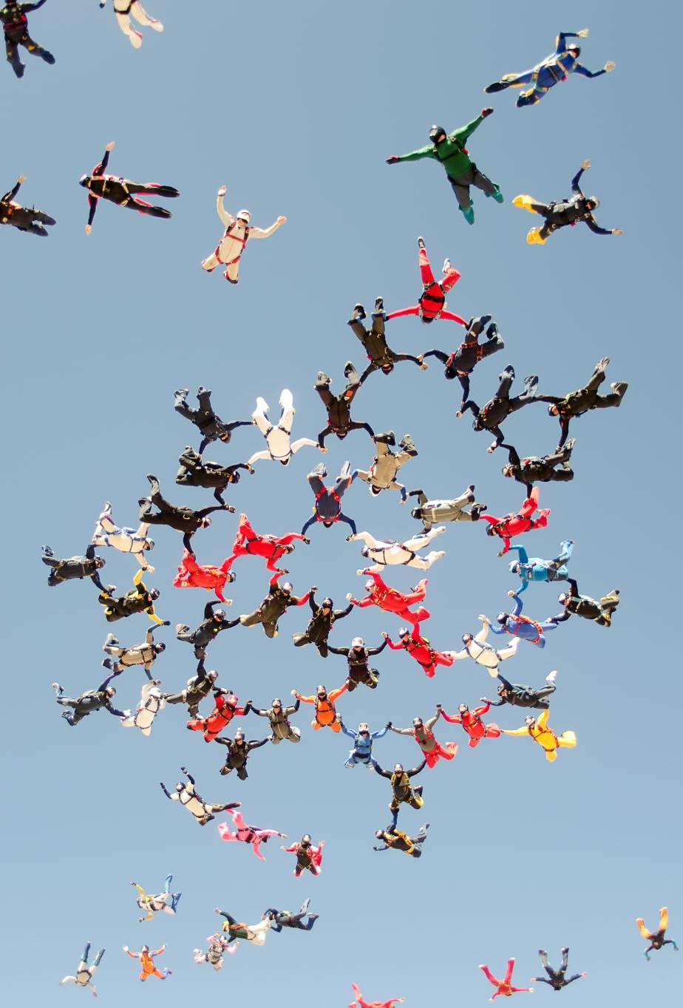
Action Plan
Identify individuals to build a Scrum Agile Team.
Train these individuals in Scrum Agile Practices by financing a workshop.
Identify a trial project for this Scrum Agile Team.
Assess the results of that trial project.
If the results are positive, determine what it would take to adopt Scrum Agile practices across our organization.

Slide 23

Questions/Discussion
What would you like to know about Agile Scrum Teams?
What pain points are you currently experiencing in your project framework?
How do you see Agile Scrum Team management fitting into your world?

Slide 24
References
Charles G. Cobb. (2015). The Project Manager’s Guide to Mastering Agile : Principles and Practices for an Adaptive Approach. Wiley.
Kulkarni, A. (2018, April 12). Agile Tester Skills. Welcome to World of Agile. https://worldofagile.com/blog/agile-tester-skills/#:~:text=The%20role%20of%20a%20tester%20in%20an%20Agile
‌What Is the Agile SDLC and How Does It Work? | Synopsys. (n.d.). Www.synopsys.com. Retrieved December 9, 2022, from https://www.synopsys.com/glossary/what-is-agile-sdlc.html#

